Slide 1
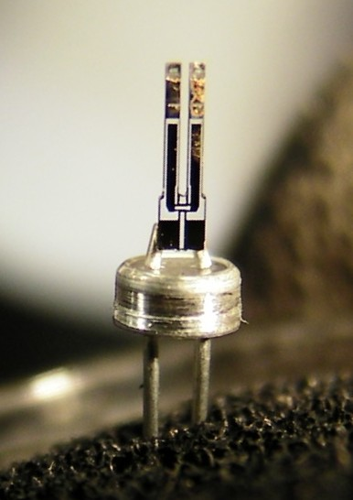
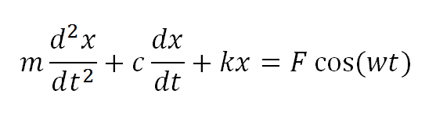

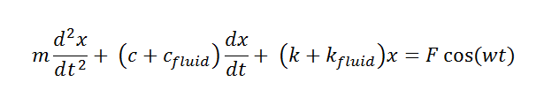
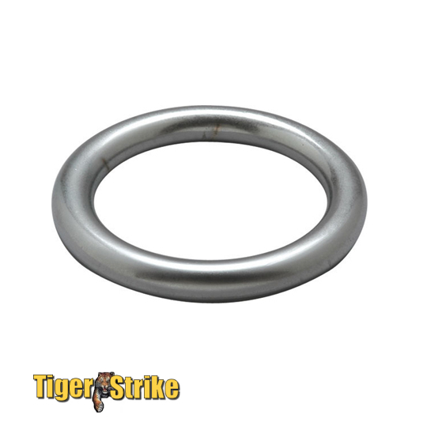
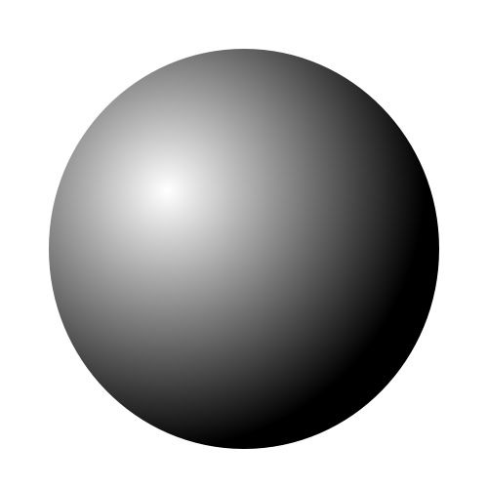
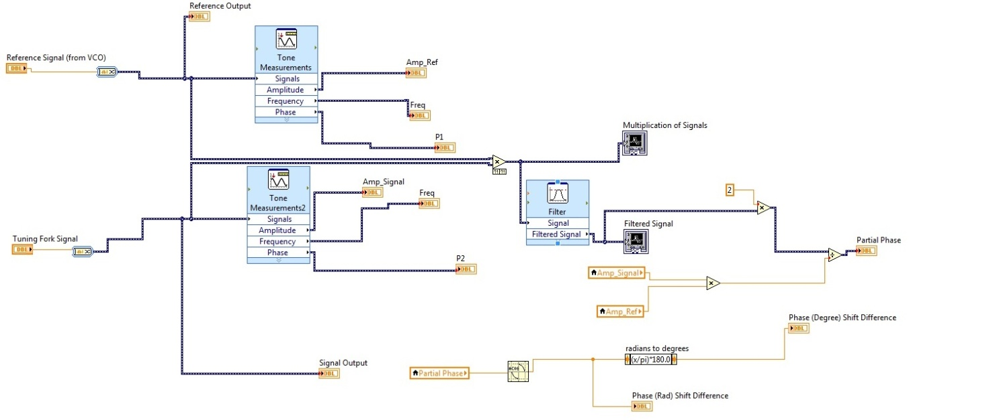
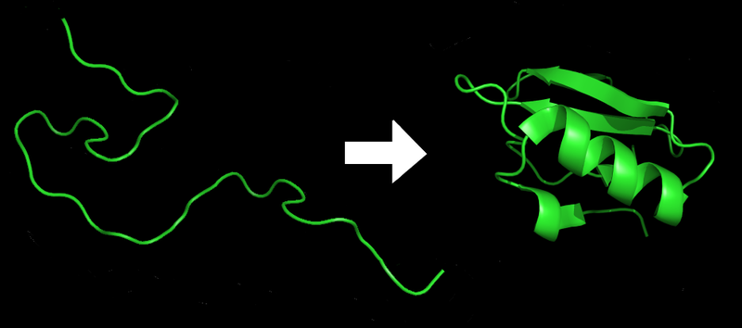
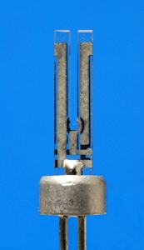
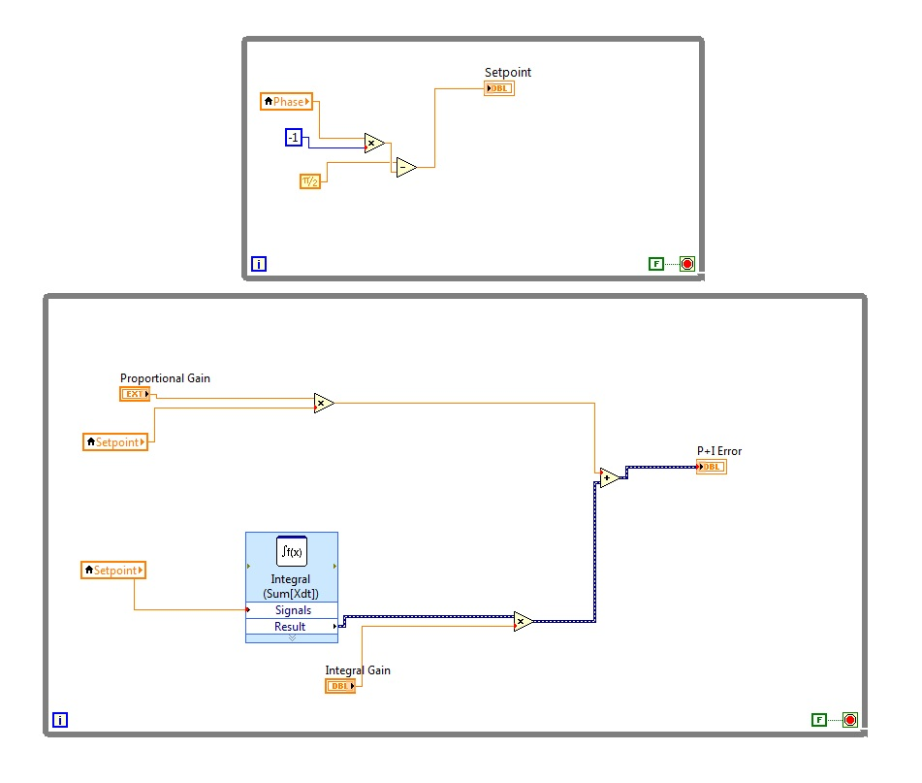
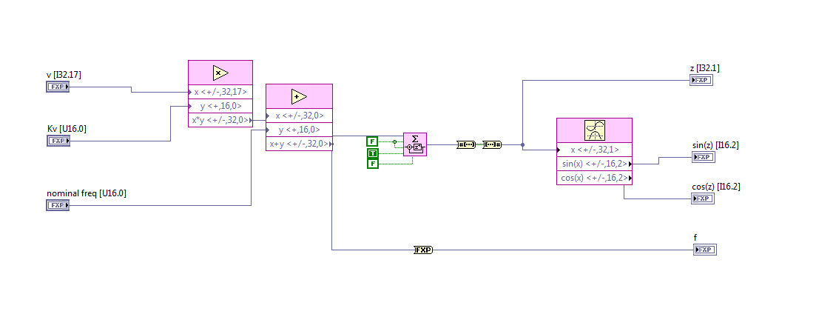
Frequency Modulation Feedback Control for Near-Field Acoustic Characterization of Mesoscopic Fluid Films
Pramith Devulapalli
BACKGROUND INFORMATION
EXPERIMENTAL DESIGN PT. 1: TIP FABRICATION
FURTHER ANALYSIS
Oscillates
Laterally
The quartz tuning fork (QTF) is a special type of oscillator that has two prongs oscillating laterally in a mirrored fashion. The oscillation occurs when an alternating current, containing a frequency around 30,000 Hz, is passed through the electrical contacts. The amplitude of the QTF’s vibrations is measured by the magnitude of the current in the prongs. At a frequency called resonance, the QTF’s vibrations are at its maximum. Also, the resonance frequency yields a 90 degree phase shift between the current in the electrical contacts.
The diagram on the right models the tip fabrication method, which is called electrochemical etching. Electrochemical etching is very important in creating very sharp probes needed for the SANM experiment. These very sharp probes experience the effects of the confined fluid and these probes themselves need to be carefully manufactured in order to obtain the best results.
The real question is how exactly does tip fabrication tie into the innovative method? Without proper tips, the information gathered from the confined liquid will not be of the best quality and cannot be properly analyzed.
How exactly does the information obtained from frequency modulation help characterize the mesoscopic fluid?
TF in Air:
+
−
TF
in Liquid
Electrical Contact
Electrical Contact
Mesoscopic is the region between the macroscopic and the microscopic world.
Weight of ball pressing down
1
2
3
4
The liquid forms a meniscus in contact with the ball
The second order inhomogeneous differential equations represent the equation of motion of a forced harmonic oscillator. The forced harmonic oscillator describes the dynamics of the tuning fork accurately. There are two differential equations. The first differential equation represents the factors of the tuning fork in air. The second differential equation represents the factors of the tuning fork in liquid. In order to get the damping coefficient of the fluid, c_{fluid} , and the elastic coefficient, k_{fluid} , the two equations are compared. The damping and elastic coefficient in air are calculated and by comparing the two equations, the differences between the damping and elastic coefficients can be attributed to the properties of the fluid. The readings from the tuning fork, mainly amplitude and frequency, are used to calculate the values of both the coefficients. The data SANM provides is crucial in solving these equations and other complex equations to calculate the various coefficients.
Liquid exists at a finite thickness
between the ball and ground
Ball
Liquid is squeezed into
a molecularly-thin film
The whole illustration above depicts the electrochemical etching process perfected by me. In the first phase, the gold wire is dipped into the HCL liquid with a meniscus forming. In the second stage, the alternating current from the power supply “eats away” at the gold metal creating a section that is very thin. After a while of etching, a meniscus is barely visible and the etching occurs at a different point. If I let this happens, this creates jumps in the tip that are not wanted. In the third stage, I manually dip the wire lower into the liquid to regain the same meniscus. This process repeatedly happens to keep the meniscus from falling. In the fourth stage, a clean, sharp tip results from this method of electrochemical etching.
Ground
The diagram above models the mesoscopic fluid confined between two surfaces: the ball and the ground. The phenomenon of confined liquids has puzzled scientists for years. When a molecularly thin film of water is squeezed between two surfaces, the properties of this liquid are different from those found in macroscopic (bulk) liquids. The viscosity is much higher and molecular ordering appears. The molecules in the liquid tend to rigidly align together and this type of molecular ordering is observed in solids with rigid structures. These varying properties of the mesoscopic fluid under confined conditions have potential implications in tribology, engineering, and biology.
EXPERIMENTAL DESIGN PT. 2: THE INNOVATIVE METHOD
The Lock-In Amplifier is the heart of frequency modulation. The job of the Lock-In Amplifier is to extract phase, amplitude, and frequency from any electrical signal. The Lock-In performs its job by obtaining two signals, a reference signal and an input signal, and applying a series of mathematical operations to decode the key components.
The PID's job is to see if the signal is at resonance. The PID identifies a variable, the phase identified by the Lock-In, and compares it to a set point or a goal. The set point is 90 degrees because that is where resonance is located. Depending on the difference between the measured variable and the set point, the PID outputs a calculated error that runs to the next stage.
Lock-In Amplifier
APPLICATIONS
Tuning Fork Signal
Tuning Fork Piezo Holder
Tuning Fork Signal
Stage 1
If the phase does not equal the set point, the PID will constantly output an error. If the phase equals the set point, then the PID maintains that error level and does not add any error.
A Novel Proposition
Quartz Tuning Fork
Stage 4
Frequency Modulation/Phase Locked Loop
Stage 2
Fabricated Tip
Confined Liquid ≈ 20 nm
Quartz Tuning Fork
PID Microcontroller
Acoustic Signal
Output Signal (goes to Lock-In)
Initial State
Final State
Solid Substrate
The application of SANM with frequency modulation into protein folding is a highly unique and intriguing venture. Protein folding is the process of a protein evolving from its initial state to its final state. When a protein incorrectly folds, these toxic proteins can potentially lead to the development of neurodegenerative disorders such as Alzheimer’s and Parkinson’s disease.
Acoustic Sensor
Input Signal (comes from VCO)
Stage 3
The Shear Force Acoustic Near-Field Microscope (SANM) is an instrumentation used to investigate the properties of confined liquids. SANM probes liquids at ranges of nanometers to angstroms. An electrical current vibrates the QTF at the resonant frequency, which is held in place by the piezo holder. As the tuning fork’s vibrations expand and contract laterally, the tip attached to one of the prongs also moves in a similar fashion. The whole apparatus approaches the liquid and the fabricated tip plunges into the mesoscopic liquid. With the tip as one surface and the substrate as the other surface, the liquid is confined and demonstrates unique properties. The disturbances in the fluid caused by the tip vibrations are recorded by the acoustic sensor. Due to the viscosity of the liquid, the amplitude of the QTF decreases and these changes are recorded.
The QTF is the center of SANM with frequency modulation. The Lock-In obtains the output signal (input for Lock-In) of the QTF and analyzes the phase shift against the input signal (reference for Lock-In). The measured phase shift of the output signal is transferred to the PID to check if the phase is 90 degrees. If it is not 90 degrees, the PID outputs the error to the VCO to either pump up or down the driving frequency of the QTF. The VCO generated frequency is the local resonant frequency of the QTF.
Voltage Controlled Oscillator
The Voltage Controlled Oscillator is the third stage of frequency modulation. The VCO receives the PID output error as an input signal. Depending on the PID output error, the VCO adds or subtracts a certain number of Hertz to the nominal frequency. The nominal frequency is the base frequency where the VCO starts. With the VCO relying on the PID error to shift the frequency upwards or downwards, the resonant frequency is guaranteed.
Protein folding starts with a protein in its initial state. The protein is composed of several amino acids. These amino acids are either hydrophilic or hydrophobic. This protein then evolves into its final state. Unfortunately, the transition process from the initial to final state is relatively unknown by the scientific community. Although, it is known that one of the major driving forces of protein folding is the interaction between hydrophobic amino acids.

